Slide 1
iSKKUBot
RAG-based Multilingual Chatbot for Exchange Students at SKKU
Notes:
So, this is geonwoo in team H, developing iSKKUBot, a RAG-based Multilingual Chatbot for Exchange Students at SKKU.

Slide 2

EQUIPO SASHIMI
GeonWoo Bang
JungYoon Hwang
Jiae Choi
Mikel Larrarte Rodriguez
Notes:
this is our team EQUIPO SASHIMI.

Slide 3
Table of contents.
1
Progress & Role
What have we done & role assignment
2
Front-end
UX/UI
3
Demo
Demo of our RAG model
4
Evaluation
Evaluation result of our RAG model
4.1
Retriever evaluation
Evaluation result of our retriever model
4.2
RAG evaluation
Evaluation result of our RAG model
Notes:
Today's presentation will cover the following topics.

Slide 4
Progress & Role
1
What have we done & role assignment
Notes:
This is what have we done and our role assignment

Slide 5
Timeline
 | Week 6 | Week 7 | Week 8 | Week 9 | Week 10 | Week 11 | Week 12 | Week 13 | Week 14 | Week 15
Scrap form Web/PDF |  |  |  | done
Construct Database |  |  |  | done
Implement RAG(Retriever) |  |  |  | done
Implement RAG(Generator) |  |  |  | done
Evaluate |  |  |  |  |  |  |  | Working
Implement Back-end |  |  |  |  |  |  |  | Almost done
Implement Front-end |  |  |  |  |  |  |  | Almost done
Notes:
We’re all done about constructing vector database and implementing RAG model, and we’re trying to serve it as much as we can, and also doing an evaluation

Slide 6
Roles
Front-end [ Jiae ]
Back-end(API)[ Geon Woo ]
Evaluate
Human eval - google form
RAG evaluation [ Mikel, JungYoon ]
Notes:
Jiae took frontend, and i took Back-end, and evaluation part is for mikel and jungyoon

Slide 7
Front-end
2
UX/UI
Notes:
Now, let's review what we have implemented so far.

Slide 8
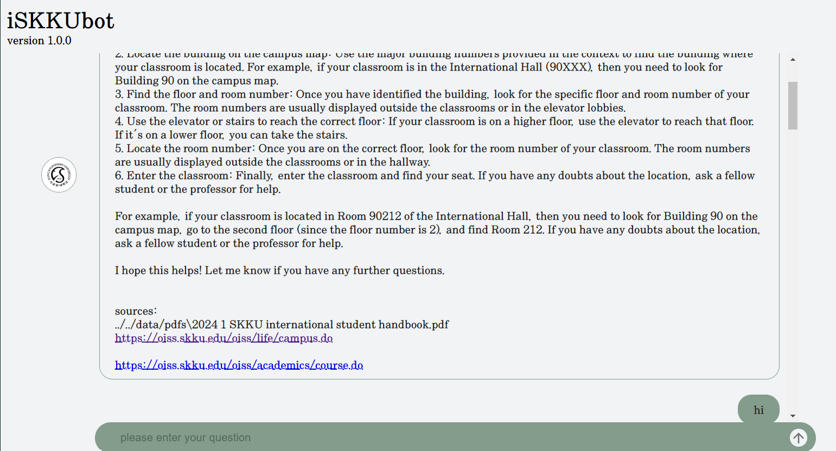


Front-end
Function 1. Send message to Chatbot
Notes:
So, for the frontend, we added some new functions to the UI components. One of them is the functions to send messages to the chatbot. Basically, users can type their questions into an input field and send them by pressing Enter or clicking the Send button.
But here’s the thing—if someone sends a bunch of questions while the chatbot is still working on a response, it can cause some issues. Since we’re using streaming responses, if a new question comes in while the chatbot is mid-reply, the answers can get all jumbled up.
To avoid this problem, we made sure the Enter key and Send button don’t work while the chatbot is typing. We did this by adding a state called isChatbotTyping. When this state is false, the Enter key and Send button are enabled. When it’s true, they’re disabled. Pretty simple but super important for keeping things running smoothly.

Slide 9
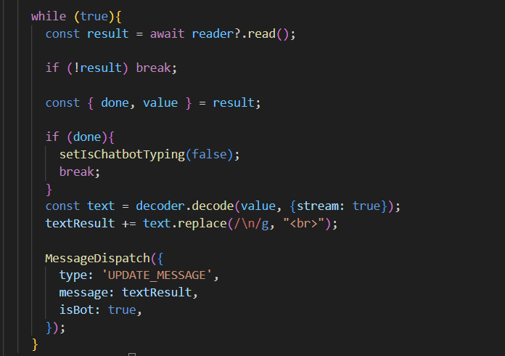
Front-end
Function 2. Receiving chatbot message
Source links
Get Streaming Response
Notes:
Now, let’s talk about the second function, which is about receiving messages from the chatbot.
Like we mentioned earlier, we’re using a streaming response to deliver the chatbot's answers.
What this means is that users can see the chatbot’s response appearing word by word, instead of having to wait for the whole message to be generated. The chatbot’s message gets updated in real time as each word comes in, so it feels a lot more dynamic and interactive.
Additionally, we added a feature to handle HTML tags in the chatbot's response. This allows the chatbot to show things like line breaks for better readability and even hyperlinks for source references. We think these features not only make the messages easier to read but also help build trust by linking to sources when needed.

Slide 10
Front-end
Context API - to manage message state
Why Context API?
Using ‘useState’ for managing the states and their update logic is too complex.
Context API - Able to separate the states and the update logic from UI component
2. The states need to be accessed by multiple components
Provider of Context API - All components can access the context state directly
3. The states are not complex enough to installing other libraries
Context API - Don’t have to install
Notes:
let’s go over how we manage message states.
So, we decided to go with the Context API for managing the message states, and here’s why:
First off, using useState for this would’ve been way too complicated. We had to manage a lot of different states—like the entire message list, the current chat’s messages, and even speaker info for each message. On top of that, the logic for updating these states—things like message input, sending messages, and starting new chats—gets pretty tricky.
Trying to handle all that directly in the UI components would’ve been messy and error-prone. The Context API let us separate the states and their update logic from the UI, which made everything way cleaner and more manageable.
Another reason is that multiple components, including deeply nested ones, needed access to these states. If we used useState, we’d have to pass states down through props, which can get really inefficient as the component structure gets more complex which is called props drilling problem. By using the Context API with a Provider, all the components can access the context state directly, no matter where they are in the hierarchy.
Lastly, we didn’t think the states were complex enough to justify using external state management libraries like Recoil or Zustand. Since the Context API is built into React, it’s lightweight, easy to use, and perfect for what we needed. So, it just made sense to go with it.

Slide 11
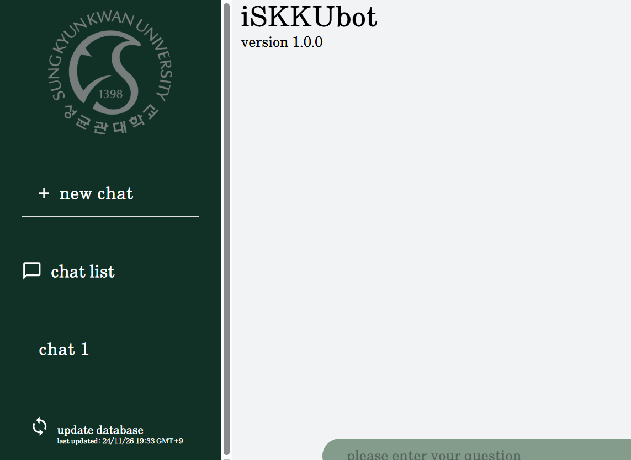
Front-end
Function 3. Database update timestamp, New chat
Click to create new chat
Visit previous chats here!
Check update timestamp
Notes:
Now, let’s talk about the third function, which is displaying the database update timestamp and creating new chats.
First, about the timestamp: our chatbot updates its web-scraped data once a day to make sure the information it provides is always up-to-date. To let users know how recent the data is, we display the last update timestamp at the bottom of the interface. It’s a simple way to add transparency and build user trust.
Next, for starting new conversations: users can click the New Chat button on the left to start a fresh chat. All previous conversations are still accessible through the sidebar menu, so users can easily revisit them. However, there’s one limitation—if the page is refreshed, all chat histories will be reset. So, we’re keeping it simple for now, but it’s something we could improve on later!

Slide 12
Back-end
3
Creating API Endpoints
Notes:
Let me explain the API endpoints implemented in the backend.

Slide 13
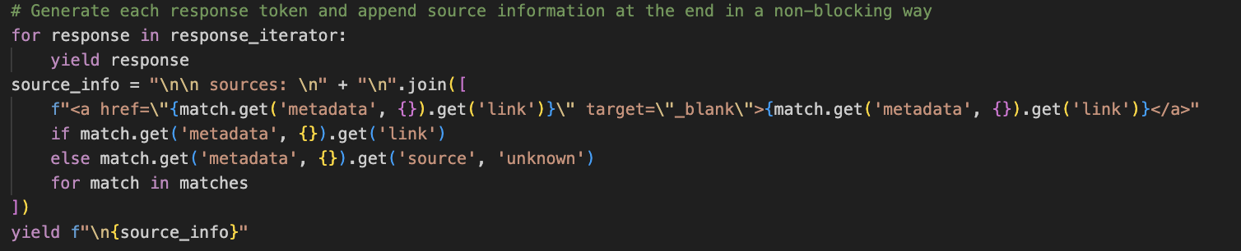
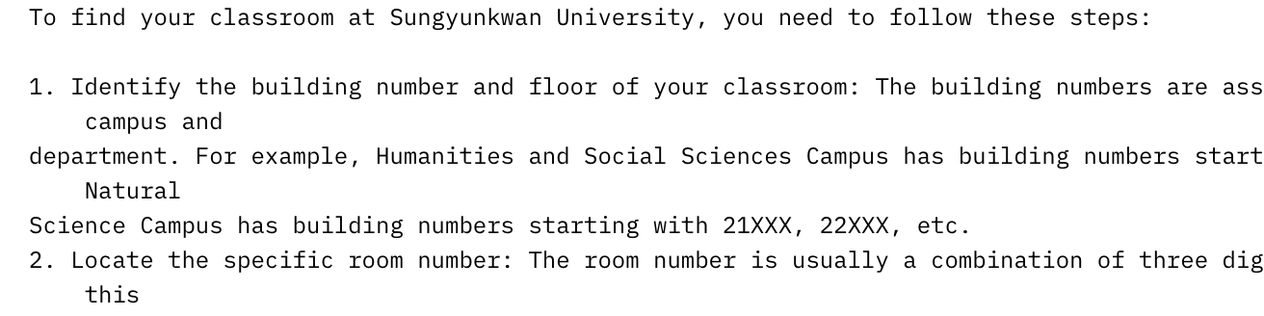
POST: chat
Asynchronous provision of generated tokens using the yield method.
Add Sources below.
Notes:
First, we have the POST endpoint for the chat functionality. As previously mentioned, this uses a streaming response format, where tokens are generated and sent to the front-end word by word.
In addition to this, as explained earlier, we’ve integrated a feature that retrieves the source information from the metadata stored in the database. This ensures that the chatbot provides clear source references. The source information is also delivered to the front-end using the yield method, making it part of the streaming response.

Slide 14
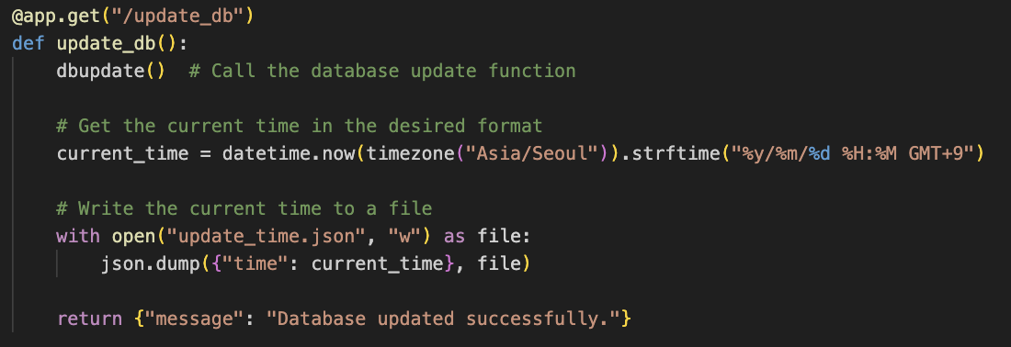
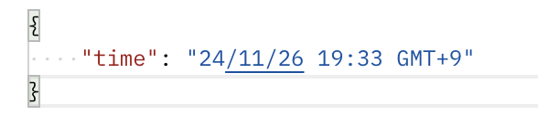
GET: update_db
Performing DB update when GET update_db is executed.
Notes:
Next is the GET endpoint for the update_db function. This endpoint is designed for updating the database. When this function is called, it triggers the dbupdate function on the server. This function re-crawls the web, identifies any changes, and overwrites only the updated parts in the vector database.
However, this functionality is restricted to administrators. The reason is that frequent update calls can result in significant resource wastage. To address the potential for excessive updates, we’ve proposed the following solution:

Slide 15
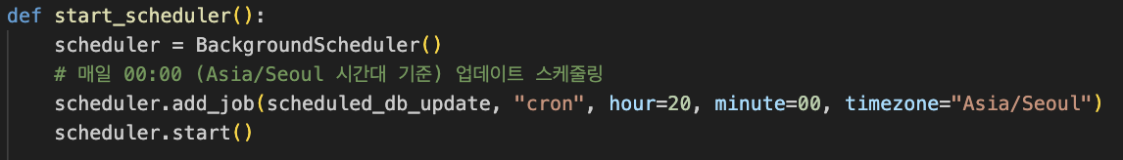
Auto: update_db
Automated DB updates through scheduler execution at setted intervals.
Notes:
The solution is an automatic database update using a scheduler.
Once the server is running and the FastAPI app starts, the scheduler is immediately activated. It is configured to trigger the dbupdate function every day at midnight on korean time zone.
This setup ensures that the database is consistently updated daily, providing users with the most recent and accurate information. It’s a resource-efficient approach that keeps the system up-to-date without requiring manual intervention.

Slide 16
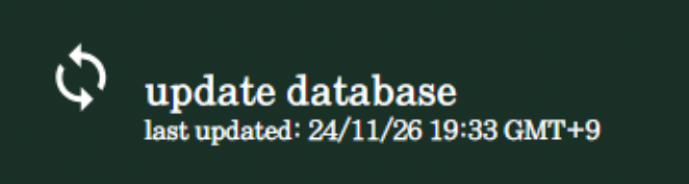
GET: last_update
Providing users with the final database update time.
Notes:
Finally, there’s the last_update endpoint.
This endpoint is designed to display the last database update time on the interface. It retrieves the timestamp recorded by the dbupdate function and sends it to the front-end.

Slide 17

Deployment
Deployment
Convenient CI/CD process
Free credit
Vercel
Notes:
Since we’ve almost finished the front-end, back-end development, we decided to deploy it. The thing is, we don’t have our own server for deployment(not for RAG), so we went with Vercel as our deployment platform.
Vercel is super convenient because it automatically redeploys the project every time we push code to our GitHub repository. This makes the CI/CD process smooth and hassle-free. Plus, they offer free credits, which is another big reason why we chose it. It’s efficient, cost-effective, and perfect for our needs right now.

Slide 18
Demo
4
Demo of our RAG model
Notes:
Next is Demo.

Slide 19
Demo
https://iskkubot.vercel.app/
Notes:
We’ve prepared a demo, but unfortunately, it’s not running at the moment. Yesterday, due to a heavy snowfall, there was a power outage affecting my local desktop server. which is for RAG model. Since then, the network hasn’t been restored. I’m really sorry about this, and I’m working on getting someone to fix the issue as soon as possible.
However, frontend is still available. you can see this.

Slide 20
Evaluation
5
Trials to solve RAG’s main challenges
Notes:
Finally, let’s take a look at the evaluation part.

Slide 21
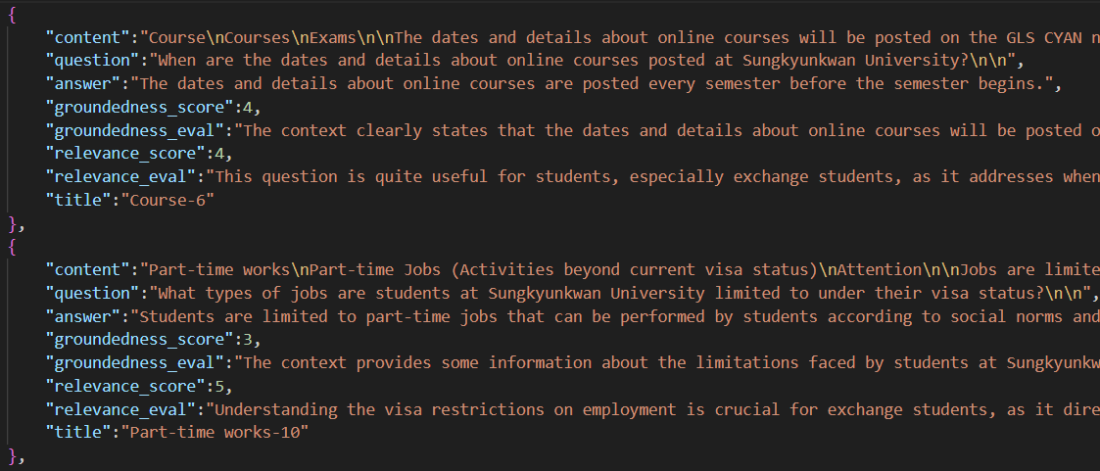
Evaluation dataset
Context, question, answer pair
Notes:
We prepared evaluation dataset which contains context, question, and answer pair.
And filtered them based on groundedness and relevance.

Slide 22
5.1 Retriever
The retriever might retrieve a context that is relevant to the query, but not the one used to generate it
There is no way to mark this case as correct
generate
Context_1
Context_2
Context_3
Query_1, Answer_1
relevant
Notes:
Based on the generated evaluation dataset, we tried to evaluated our retriever model.
But as we implemented the evaluation, a critical issue came to our mind.
That is, the query might be better answered with different context then the one used to generate the query, since there are many similar contexts.
However, even if the retriever retrieves relevant context but not the one used to generate the query, there is no way to mark it as correct.

Slide 23
5.2 RAG
Steps:
Synthetic Evaluation Dataset ✅
Set up a judge agent → GPT 4o-mini
Decide RAG evaluation metric:
Faithfulness.
Notes:
So, we concluded to evaluate the RAG model as a whole, not separately.
Here’s the process we’re following:
First, we created a synthetic evaluation dataset with QA pairs specifically about Sungkyunkwan University. This dataset serves as the foundation for our testing.
Next, we needed to decide on a model to act as a judge for evaluating the system’s performance. We chose GPT 4o mini because of its excellent capabilities for this kind of task.
Finally, we had to determine the evaluation metric. For RAG systems, there are several commonly used metrics, but in our case, we decided to focus on faithfulness. This metric measures how closely the generated answers align with the “ground truth,” ensuring that the responses are accurate and reliable.

Slide 24
5.2 RAG
EVALUATION_PROMPT = """###Task Description: A response to evaluate, a reference answer that gets a score of 5, and a score rubric representing an evaluation criteria are given. 1. Write a detailed feedback that assess the quality of the response strictly based on the given score rubric, not evaluating in general. 2. After writing a feedback, write a score that is an integer between 1 and 5. You should refer to the score rubric. 3. The output format should look as follows: \"Feedback: {{write a feedback for criteria}} [RESULT] {{an integer number between 1 and 5}}\" 4. Please do not generate any other opening, closing, and explanations. Be sure to include [RESULT] in your output. ###Response to evaluate: {response} ###Reference Answer (Score 5): {reference_answer} ###Score Rubrics: [Is the response correct, accurate, and factual based on the reference answer?] Score 1: The response is completely incorrect, inaccurate, and/or not factual. Score 2: The response is mostly incorrect, inaccurate, and/or not factual. Score 3: The response is somewhat correct, accurate, and/or factual. Score 4: The response is mostly correct, accurate, and factual. Score 5: The response is completely correct, accurate, and factual. ###Feedback:"""
Notes:
To make this clearer, let me explain the evaluation prompt.
In the prompt, we specify the evaluation method directly. This means we clearly define what we want the model to focus on while grading the answers.
We also include score rubrics, which provide the model with guidelines on how to evaluate the answers. These rubrics outline specific criteria so the evaluation is consistent and objective.
Lastly, we ask the model to provide feedback based on the rubric. This feedback helps us understand the reasoning behind the evaluation. and further more, it also helps GPT to assign more reasonable scores based on there thinking. After that, the model assigns a score on a scale from 1 to 5, giving us a quantitative measure of the answer’s quality.
This structured approach ensures a thorough and reliable evaluation process.

Slide 25

5.2 RAG
Evaluate the system using generated answers.
Notes:
The last part would be to actually evaluate the system using generated answers. We are working on it now and we should have the results soon. Sorry for late cuz of server network issue.

Slide 26
Next Tasks
Debug
Testing…?
Notes:
And we’re planning to do debugging and testing too.

Slide 27
References
https://velog.io/@byu0hyun/FastAPI%EC%99%80-OpenAI-%EB%B9%84%EB%8F%99%EA%B8%B0-%EC%8A%A4%ED%8A%B8%EB%A6%AC%EB%B0%8D-%EC%82%AC%EC%9A%A9
https://medium.com/@mauryaanoop3/the-indispensable-reranker-a-deep-dive-into-optimizing-retrieval-in-retrieval-augmented-generation-a12793ee393c
https://www.pinecone.io/learn/series/rag/rerankers/
https://huggingface.co/learn/cookbook/rag_evaluation
Notes:
this is our references.

Slide 28
Thank you!
Do you have any questions?
Notes:
Thanks

